Slide 1
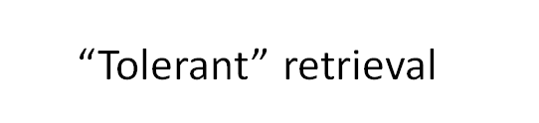
“Tolerant” retrieval

Slide 2
“Tolerant” retrieval:
Wild-card queries

Slide 3
Wild-card queries: *
Sec. 3.2
mon*: find all docs containing any word beginning with “mon”.
Easy with binary tree (or B-tree) lexicon: retrieve all words in range: mon ≤ w < moo
*mon: find words ending in “mon”: harder
  Maintain an additional B-tree for terms backwards.
  Can retrieve all words in range: nom ≤ w < non.
Exercise: from this, how can we enumerate all terms
meeting the wild-card query pro*cent ?
Notes:
Wild card 外卡; 通配符; 未知数

Slide 4
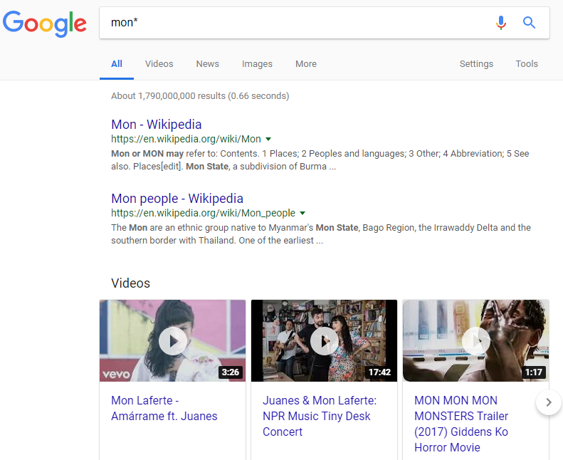
Example: Wild-card queries

Slide 5
Query processing
Sec. 3.2
At this point, we have an enumeration of all terms in the dictionary that match the wild-card query.
We still have to look up the postings for each enumerated term.
E.g., consider the query:
se*ate AND fil*er
This may result in the execution of many Boolean AND queries.

Slide 6
B-trees handle *’s at the end of a query term
Sec. 3.2
How can we handle *’s in the middle of query term?
  co*tion
We could look up co* AND *tion in a B-tree and intersect the two term sets
  Expensive
The solution: transform wild-card queries so that the *’s occur at the end
This gives rise to the Permuterm Index.
Notes:
Permuterm Index 轮排索引

Slide 7
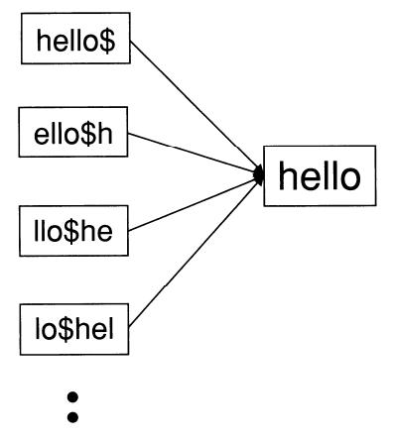

Permuterm index
Sec. 3.2.1
For term hello, index under:
  hello$, ello$h, llo$he, lo$hel, o$hell, $hello
  where $ is a special symbol.
Queries:
  *X lookup on X$*
  X*Y lookup on Y$X*
Query = hel*o
X=hel, Y=o
Lookup o$hel*
Notes:
Permuterm (Permuted term) 轮排

Slide 8
Permuterm query processing
Sec. 3.2.1
Rotate query wild-card to the right
Now use B-tree lookup as before.
Permuterm problem: ≈ quadruples lexicon size
Empirical observation for English.
Notes:
quadruplesv.（使）成四倍( quadruple的第三人称单数 )

Slide 9
Bigram (k-gram) indexes
Sec. 3.2.2
Enumerate all k-grams (sequence of k chars) occurring in any term
e.g., from text “April is the cruelest month” we get the 2-grams (bigrams)
  $ is a special word boundary symbol
Maintain a second inverted index from bigrams to dictionary terms that match each bigram.
$a,ap,pr,ri,il,l$,$i,is,s$,$t,th,he,e$,$c,cr,ru,
ue,el,le,es,st,t$, $m,mo,on,nt,h$

Slide 10
Bigram index example
Sec. 3.2.2
The k-gram index finds terms based on a query consisting of k-grams (here k=2).
$m
mace
madden
mo
among
amortize
on
along
among

Slide 11
Processing wild-cards
Sec. 3.2.2
Query mon* can now be run as
  $m AND mo AND on
Gets terms that match AND version of our wildcard query.
But we’d enumerate moon.
Must post-filter these terms against query.
Surviving enumerated terms are then looked up in the term-document inverted index.
Fast, space efficient (compared to permuterm).

Slide 12
Processing wild-card queries
Sec. 3.2.2
As before, we must execute a Boolean query for each enumerated, filtered term.
Wild-cards can result in expensive query execution (very large disjunctions…)
  pyth* AND prog*
If you encourage “laziness” people will respond!
Which web search engines allow wildcard queries?
Search
Type your search terms, use ‘*’ if you need to.
E.g., Alex* will match Alexander.

Slide 13
“Tolerant” retrieval:
Spelling correction

Slide 14
Spell correction
Sec. 3.3
Two principal uses
  Correcting document(s) being indexed
  Correcting user queries to retrieve “right” answers
Two main flavors:
  Isolated word
    Check each word on its own for misspelling
    Will not catch typos resulting in correctly spelled words
    e.g., from → form
  Context-sensitive
    Look at surrounding words,
    e.g., I flew form Heathrow to Narita.

Slide 15
Document correction
Sec. 3.3
Especially needed for OCR’ed documents
  Correction algorithms are tuned for this: rn/m
  Can use domain-specific knowledge
    E.g., OCR can confuse O and D more often than it would confuse O and I (adjacent on the QWERTY keyboard, so more likely interchanged in typing).
But also: web pages and even printed material have typos
Goal: the dictionary contains fewer misspellings
But often we don’t change the documents and instead fix the query-document mapping

Slide 16
Query mis-spellings
Sec. 3.3
Our principal focus here
  E.g., the query Maichl Jacshon
We can either
  Retrieve documents indexed by the correct spelling, OR
  Return several suggested alternative queries with the correct spelling
    Did you mean … ?

Slide 17
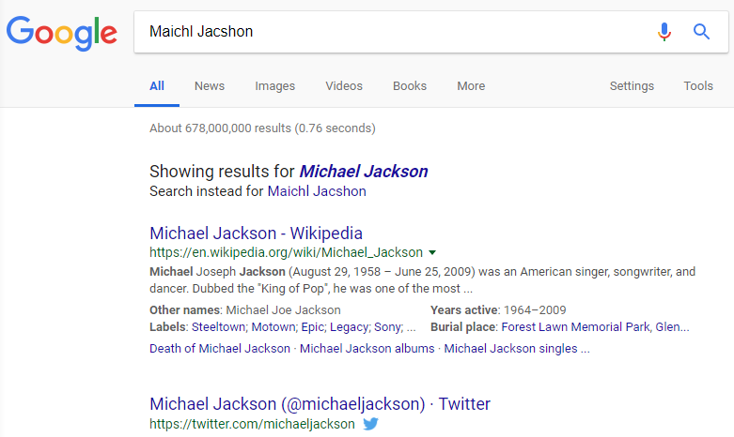
Spelling correction

Slide 18
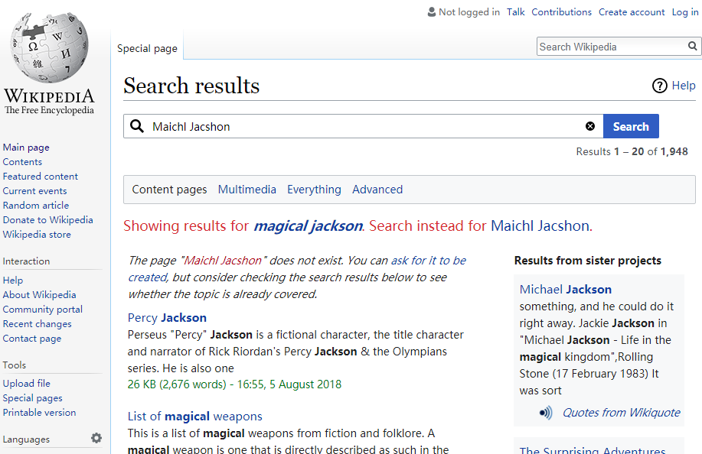
Spelling correction

Slide 19
Isolated word correction
Sec. 3.3.2
Fundamental premise – there is a lexicon from which the correct spellings come
Two basic choices for this
  A standard lexicon such as
    Webster’s English Dictionary
    An “industry-specific” lexicon – hand-maintained
  The lexicon of the indexed corpus
    E.g., all words on the web
    All names, acronyms etc.
    (Including the mis-spellings)
Notes:
acronymsn.首字母缩略词( acronym的名词复数 )
The lexicon of the indexed corpus
Give more weights to words with higher collection frequency.

Slide 20
Isolated word correction
Sec. 3.3.2
Given a lexicon and a character sequence Q, return the words in the lexicon closest to Q
What’s “closest”?
We’ll study several alternatives
  Edit distance (Levenshtein distance)
  Weighted edit distance
  n-gram overlap

Slide 21
Edit distance
Sec. 3.3.3
Given two strings S₁ and S₂, the minimum number of operations to convert one to the other
Operations are typically character-level
  Insert, Delete, Replace, (Transposition)
E.g., the edit distance from dof to dog is 1
  From cat to act is 2 (Just 1 with transpose.)
  from cat to dog is 3.
Generally found by dynamic programming.

Slide 22
Weighted edit distance
Sec. 3.3.3
As above, but the weight of an operation depends on the character(s) involved
  Meant to capture OCR or keyboard errors
  Example: m more likely to be mis-typed as n than as q
  Therefore, replacing m by n is a smaller edit distance than by q
  This may be formulated as a probability model
Requires weight matrix as input
Modify dynamic programming to handle weights

Slide 23
Using edit distances
Sec. 3.3.4
Given query, first enumerate all character sequences within a preset (weighted) edit distance (e.g., 2)
Intersect this set with list of “correct” words
Show terms you found to user as suggestions
Alternatively,
  We can look up all possible corrections in our inverted index and return all docs … slow
  We can run with a single most likely correction
The alternatives disempower the user, but save a round of interaction with the user
Notes:
disempower英 [dɪsɪm'paʊər] 美 [dɪsɪm'paʊər] vt.& vi.使自信心降低,剥夺权力

Slide 24
Edit distance to all dictionary terms?
Sec. 3.3.4
Given a (mis-spelled) query – do we compute its edit distance to every dictionary term?
  Expensive and slow
  Alternative?
How do we cut the set of candidate dictionary terms?
One possibility is to use n-gram overlap for this
This can also be used by itself for spelling correction.
Notes:
Alternative is to generate everything up to edit distance k and then intersect. Fine for distance 1; okay for distance 2. This is generally enough (Norvig).

Slide 25
n-gram overlap
Sec. 3.3.4
Enumerate all the n-grams in the query string as well as in the lexicon
Use the n-gram index (recall wild-card search) to retrieve all lexicon terms matching any of the query n-grams
Threshold by number of matching n-grams
  Variants – weight by keyboard layout, etc.
Notes:
lexicon英 [ˈleksɪkən] 美 [ˈlɛksɪˌkɑn] n.词典;专门词汇

Slide 26
Example with trigrams
Sec. 3.3.4
Suppose the text is november
  Trigrams are nov, ove, vem, emb, mbe, ber.
The query is december
  Trigrams are dec, ece, cem, emb, mbe, ber.
So 3 trigrams overlap (of 6 in each term)
How can we turn this into a normalized measure of overlap?

Slide 27
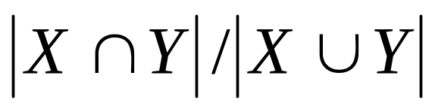
One option – Jaccard coefficient
Sec. 3.3.4
A commonly-used measure of overlap
Let X and Y be two sets; then the J.C. is
Equals 1 when X and Y have the same elements and zero when they are disjoint
X and Y don’t have to be of the same size
Always assigns a number between 0 and 1
  Now threshold to decide if you have a match
  E.g., if J.C. > 0.8, declare a match

Slide 28
Matching trigrams
Sec. 3.3.4
Consider the query lord – we wish to identify words matching 2 of its 3 bigrams (lo, or, rd)
lo
alone
lore
sloth
or
border
lore
morbid
rd
ardent
border
card
Standard postings “merge” will enumerate …
Adapt this to using Jaccard (or another) measure.

Slide 29
Context-sensitive spell correction
Sec. 3.3.5
Text: I flew from Heathrow to Narita.
Consider the phrase query “flew form Heathrow”
We’d like to respond
Did you mean “flew from Heathrow”?

Slide 30
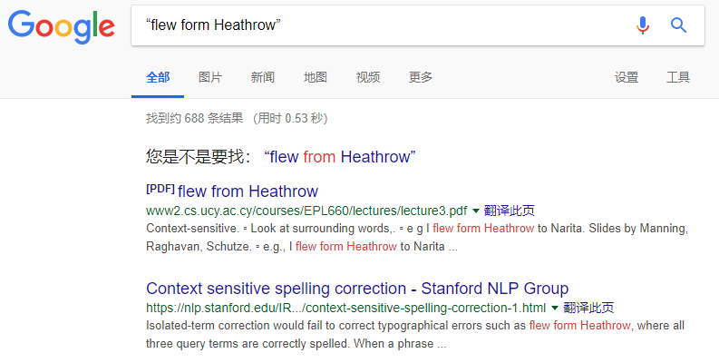
Context-sensitive spell correction

Slide 31
Context-sensitive correction
Sec. 3.3.5
Need surrounding context to catch this.
First idea: retrieve dictionary terms close (in weighted edit distance) to each query term
Now try all possible resulting phrases with one word “fixed” at a time
  flew from heathrow
  fled form heathrow
  flea form heathrow
Hit-based spelling correction: Suggest the alternative that has lots of hits.

Slide 32
Exercise
Sec. 3.3.5
Suppose that for “flew form Heathrow” we have 7 alternatives for flew, 19 for form and 3 for heathrow.
How many “corrected” phrases will we enumerate in this scheme?

Slide 33
Another approach
Sec. 3.3.5
Break phrase query into a conjunction of biwords.
Enumerate only phrases containing “common” biwords.

Slide 34
General issues in spell correction
Sec. 3.3.5
We enumerate multiple alternatives for “Did you mean?”
Need to figure out which to present to the user
  The alternative hitting most docs
  Query log analysis
More generally, rank alternatives probabilistically
  argmax_{corr} P(corr | query)
  From Bayes rule, this is equivalent to
  argmax_{corr} P(query | corr) * P(corr)
Noisy channel
Language model

Slide 35
“Tolerant” retrieval:
Soundex

Slide 36
Soundex
Sec. 3.4
Class of heuristics to expand a query into phonetic equivalents
  Language specific – mainly for names
  E.g., chebyshev → tchebycheff
Invented for the U.S. census … in 1918

Slide 37
Soundex – typical algorithm
Sec. 3.4
Turn every token to be indexed into a 4-character reduced form
Do the same with query terms
Build and search an index on the reduced forms
  (when the query calls for a soundex match)
http://www.creativyst.com/Doc/Articles/SoundEx1/SoundEx1.htm#Top

Slide 38
Soundex – typical algorithm
Sec. 3.4
Retain the first letter of the word.
Change all occurrences of the following letters to '0' (zero):
'A', E', 'I', 'O', 'U', 'H', 'W', 'Y'.
Change letters to digits as follows:
B, F, P, V → 1
C, G, J, K, Q, S, X, Z → 2
D,T → 3
L → 4
M, N → 5
R → 6

Slide 39
Soundex continued
Sec. 3.4
Remove all pairs of consecutive digits.
Remove all zeros from the resulting string.
Pad the resulting string with trailing zeros and return the first four positions, which will be of the form <uppercase letter> <digit> <digit> <digit>.
E.g., Herman becomes H655.
Will hermann generate the same code?

Slide 40
Soundex
Sec. 3.4
Soundex is the classic algorithm, provided by most databases (Oracle, Microsoft, …)
How useful is soundex?
Not very – for information retrieval
Okay for “high recall” tasks (e.g., Interpol), though biased to names of certain nationalities
Zobel and Dart (1996) show that other algorithms for phonetic matching perform much better in the context of IR

Slide 41
What queries can we process?
We have
  Positional inverted index with skip pointers
  Wild-card index
  Spell-correction
  Soundex
Queries such as
(SPELL(moriset) /3 toron*to) OR SOUNDEX(chaikofski)

Slide 42
Exercise
Draw yourself a diagram showing the various indexes in a search engine incorporating all the functionality we have talked about
Identify some of the key design choices in the index pipeline:
  Does stemming happen before the Soundex index?
  What about n-grams?
Given a query, how would you parse and dispatch sub-queries to the various indexes?
Notes:
Exercise on this slide:
Is the beginning of “what do we we need in our search engine?”
Even if you’re not building an engine (but instead use someone else’s toolkit), it’s good to have an understanding of the innards

Slide 43
Resources
Sec. 3.5
IIR 3, MG 4.2
Efficient spell retrieval:
  K. Kukich. Techniques for automatically correcting words in text. ACM Computing Surveys 24(4), Dec 1992.
  J. Zobel and P. Dart. Finding approximate matches in large lexicons. Software - practice and experience 25(3), March 1995. http://citeseer.ist.psu.edu/zobel95finding.html
  Mikael Tillenius: Efficient Generation and Ranking of Spelling Error Corrections. Master’s thesis at Sweden’s Royal Institute of Technology. http://citeseer.ist.psu.edu/179155.html
Nice, easy reading on spell correction:
  Peter Norvig: How to write a spelling corrector
  http://norvig.com/spell-correct.html

